Slide 1


Factory 360 – Real-Time Intelligence Platform
Full monitoring and analytics for factories and industrial equipment
SIC 7
BD Course
G 8

Slide 2
Agenda
Team
Introduction
Problem Statement
Methodology
Key Tasks
Results and Insights
Conclusion
Q&A
Samsung Innovation Campus

Slide 3




Team
Team
Saeed Alaa
Youssef Amgad
Ahmed Hesham

Slide 4
Agenda
Team
Introduction
The Business Challenge
The Solution
Methodology
Results and Insights
Conclusion
Q&A
Samsung Innovation Campus

Slide 5
Introduction
Industrial plants generate nonstop sensor and equipment data. This project delivers a unified data platform that monitors equipment health, detects risks, and provides real-time and historical insights.
Samsung Innovation Campus

Slide 6
Agenda
Team
Introduction
The Business Challenge
The Solution
Methodology
Results and Insights
Conclusion
Q&A
Samsung Innovation Campus

Slide 7
The Business Challenge
Energy and petroleum plants struggle to monitor emissions and equipment conditions due to the massive volume of disconnected sensor data. Toxic gas leaks pose safety risks, and exceeding legal emission limits can lead to heavy fines. Traditional monitoring lacks the real-time capability to prevent these incidents before they occur.
Samsung Innovation Campus

Slide 8
The Solution
We developed a scalable, cloud-native Data Intelligence Platform. The system processes high-velocity IoT streams to provide real-time safety alerts for hazardous emissions while simultaneously building a historical Data Lakehouse for long-term trend analysis.
Samsung Innovation Campus

Slide 9
Agenda
Team
Introduction
The Business Challenge
The Solution
Methodology
Results and Insights
Conclusion
Q&A
Samsung Innovation Campus

Slide 10
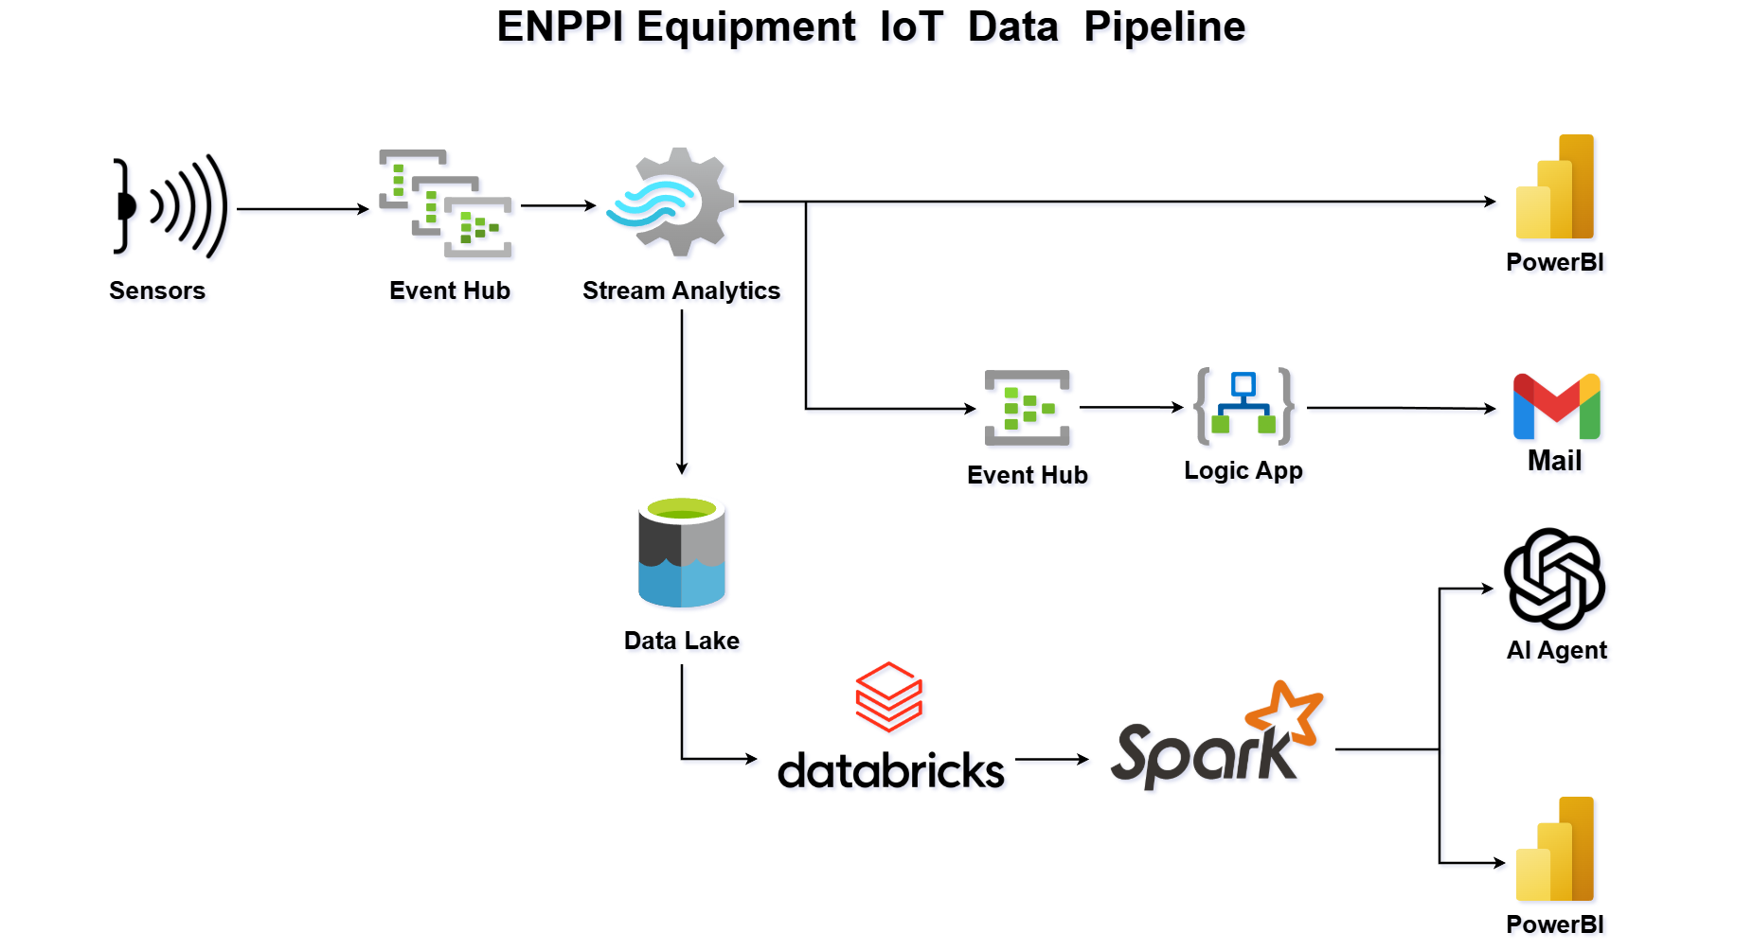
Factory 360 – Real-Time Intelligence Platform
Samsung Innovation Campus

Slide 11
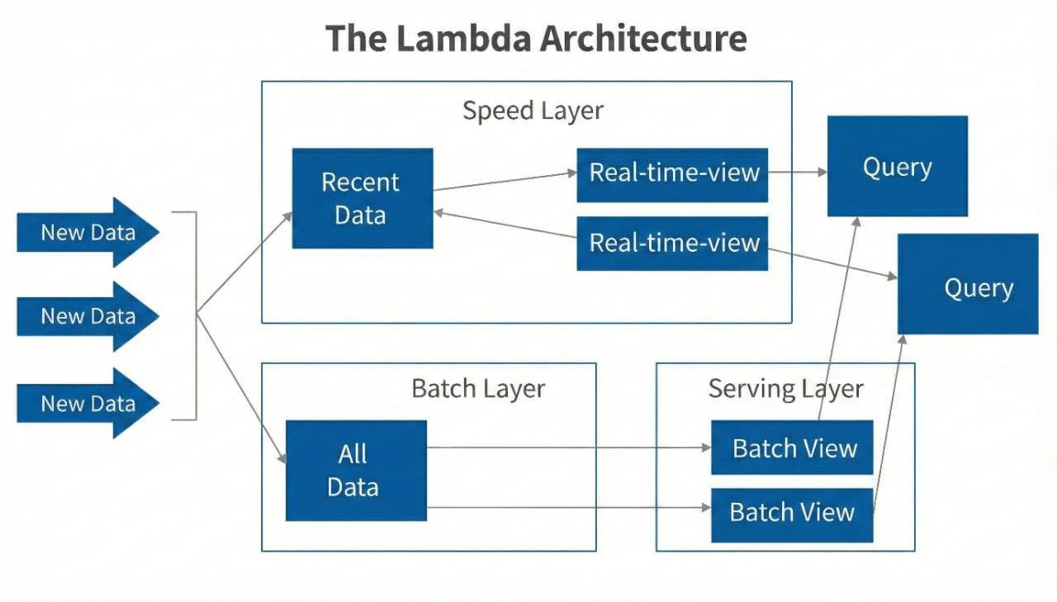
The Lambda Architecture
Samsung Innovation Campus

Slide 12
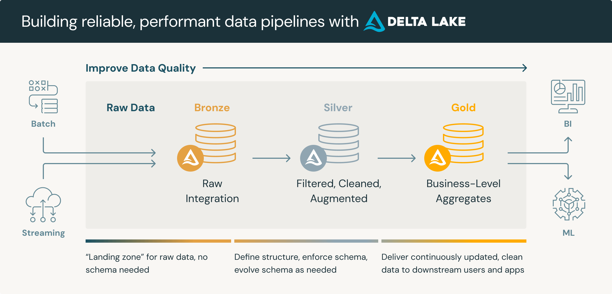
Medallion Architecture

Slide 13
Data Overview
Data Sources
The data comes from industrial sensors and equipment, capturing key operational metrics from energy and petroleum plants.
Inspired by the Carbon Majors dataset.
Data Simulation
We simulated a continuous stream with readings every 5 seconds, eventually accumulating over 10 million rows.
Gas Facilities Monitored:
Ras Gas Plant
West Nile Delta
Zohr Gas Plant
Sensor Types & Measurements:
Gas Detector: CH4, H2S, CO2, VOCs
Temperature: Ambient temperature (°C)
Pressure: Unit pressure (bar)
Wind Speed (m/s) & direction (degrees)

Slide 14
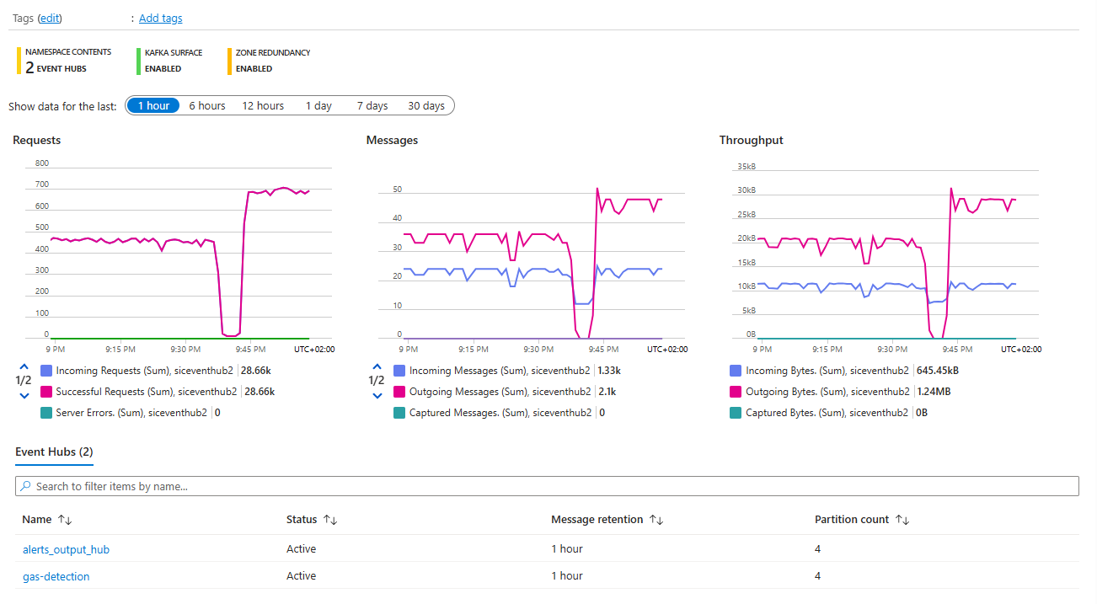
Real-Time Data Ingestion via Event Hub

Slide 15
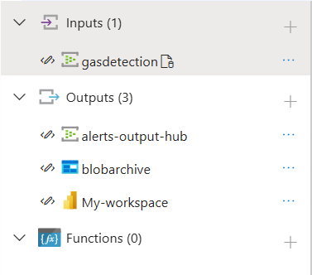
Real-Time Processing via Azure Stream Analytics
Data Ingestion & Alert Classification:
Ingests raw sensor data from Event Hub every 5 seconds.
Applies unified SQL query to detect/classify alerts (Methane Leak, High Temperature, Safety Threshold).
Multi-Output Routing:
Power BI: Real-time dashboards.
Event Hub: Triggers notifications (Logic Apps for emails).
Blob Storage: Long-term archiving.
Samsung Innovation Campus

Slide 16
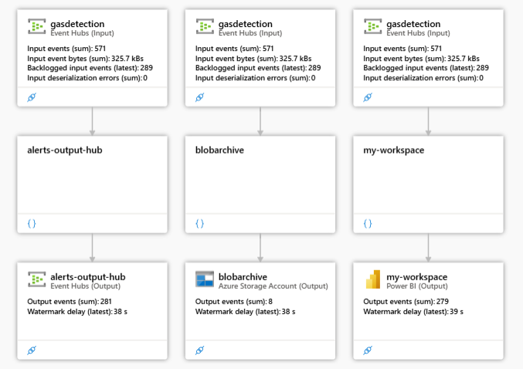
Stream Analytics Data Flow

Slide 17
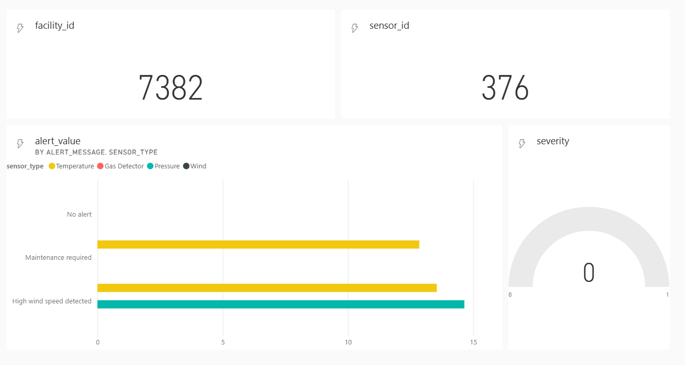
Real-Time Monitoring With PowerBI

Slide 18
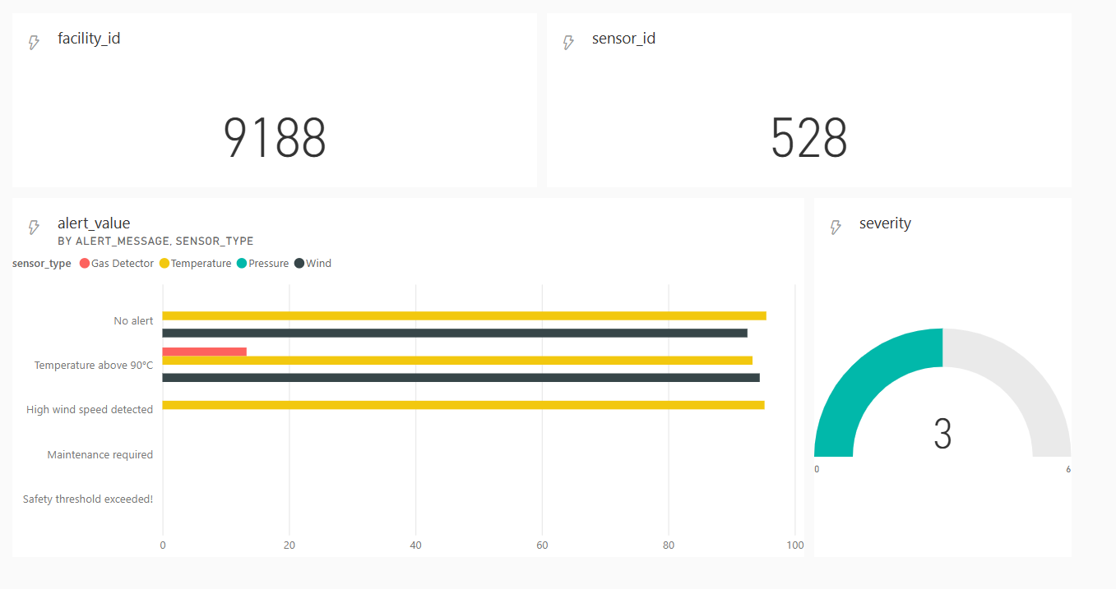
Real-Time Monitoring With PowerBI

Slide 19
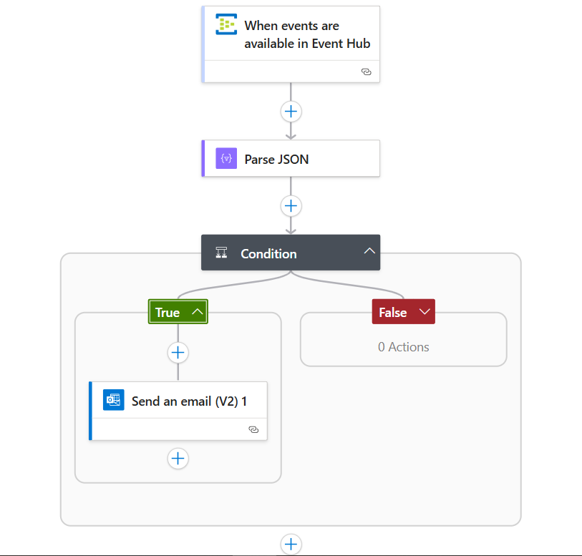
Real-Time Notifications via Logic App
Event-Driven Trigger:
Logic App listens to Event Hub for processed alerts
(every 5 seconds).
Parses JSON to extract details (type, severity, facility, sensor).
Critical Alert Filtering:
Condition checks severity ≥3 (high/critical)
If true, triggers immediate action; false skips
Email Notification:
Sends high-priority email to admin with full details (type, value, location, time)
Ensures rapid response for safety.
Samsung Innovation Campus

Slide 20
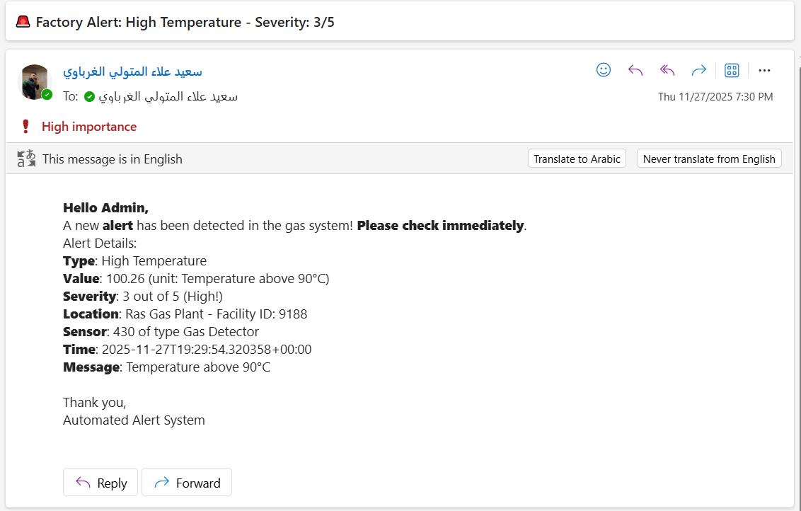
Real-Time Notifications via Mail
Samsung Innovation Campus

Slide 21
Cold Path: Historical Data Archiving in ADLS
Efficient Data Partitioning:
Stream Analytics automatically writes raw data to Blob Storage using time-based partitioning. This ensures efficient organization and fast retrieval without overwriting any existing files.
Data Preservation & Compliance:
Retains full historical records (timestamps, alerts, metrics) for long-term storage
Prevents data loss; supports auditing, trend analysis, and regulatory compliance.
Cost-Effective Integration & Access:
Seamless with Azure ecosystem (query via Databricks or export to Power BI for historical reports).
Cost-effective (pay-per-GB stored, no processing fees).
Samsung Innovation Campus

Slide 22
Bronze Layer: Incremental Raw Data Ingestion
Data Loading & Checkpointing:
Reads raw Parquet files from Blob Storage ('enppi-row-data') incrementally.
Uses last_processed_timestamp from existing Delta table to fetch only new data (ingestion_timestamp > last).
Table Creation & Merge:
Creates/overwrites Delta table ('sicinc.bronze.enppi_smart_data_inc') if new.
Merges incremental data using DeltaTable on sensor_id and event_timestamp (insert new rows only).
Efficiency & Scalability:
Handles full load on first run; subsequent runs process deltas only.
Ensures ACID transactions and schema enforcement for raw, unprocessed sensor data.
Samsung Innovation Campus

Slide 23
Silver Layer: Cleaned & Enriched Data Processing
Data Ingestion & Basic Cleaning:
Reads incremental Bronze Delta table.
Casts timestamp to TimestampType, adds date column.
Feature Engineering & Quality:
Adds risk_level (High/Medium/Low based on leaks/H2S), outlier_flag (for extreme values like PPM >500 or temp >100).
Incremental Write & Partitioning:
Merges new data into Silver Delta table ('sicinc.silver.enppi_smart_data_inc') using timestamp/sensor/facility as key.
Partitions by date(year,month,day) for query efficiency; adds ingestion_timestamp and date_key for analytics.
Samsung Innovation Campus

Slide 24
Gold Layer: Dimensional Model for Analytics
Dimension Tables (Incremental SCD & Merge):
Dim_Time: Daily dates with time attributes.
Dim_Facility: Facilities with surrogate keys.
Dim_Sensor_inc (SCD Type 2): Handles new/changed sensors (type/gas_type).
Fact Table Aggregation:
Fact_Sensor_Daily_Readings_inc: Daily summaries from Silver.
Partitions by year/month/day for efficiency.
Uses Z-Order Indexing on facility_id to speed up filtering by specific plants.
Adds gold_ingestion_timestamp to all tables for lineage.

Slide 25
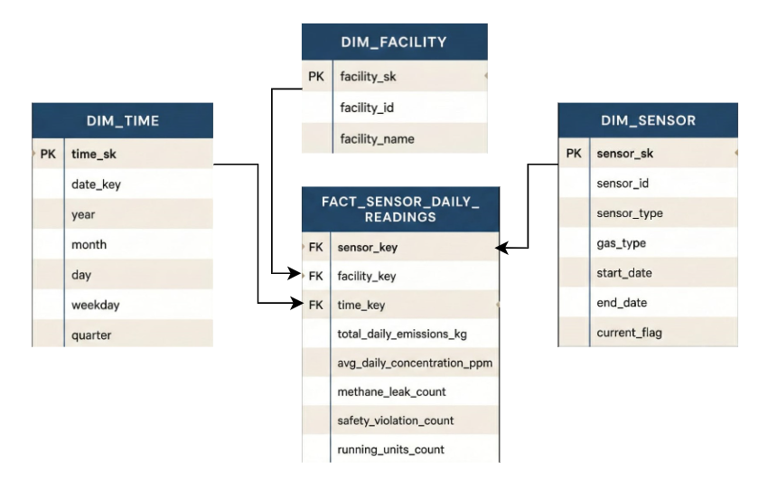
Gold Layer: Dimensional Model for Analytics

Slide 26
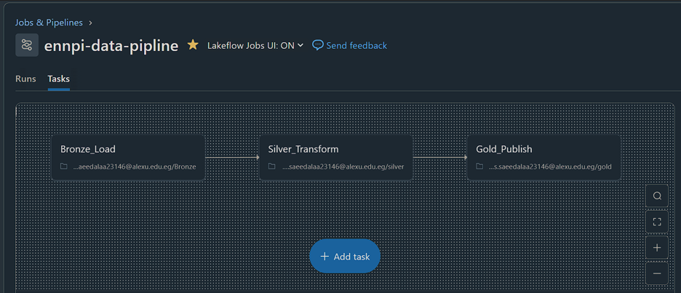
Automated Databricks Pipeline
End-to-End ETL Pipeline:
Bronze Load: Ingests raw data from Blob Storage incrementally.
Silver Transform: Cleans, enriches (risk levels, outliers), deduplicates.
Gold Publish: Builds dimensional model (dims: Time/Facility/Sensor; fact: daily aggregates).

Slide 27
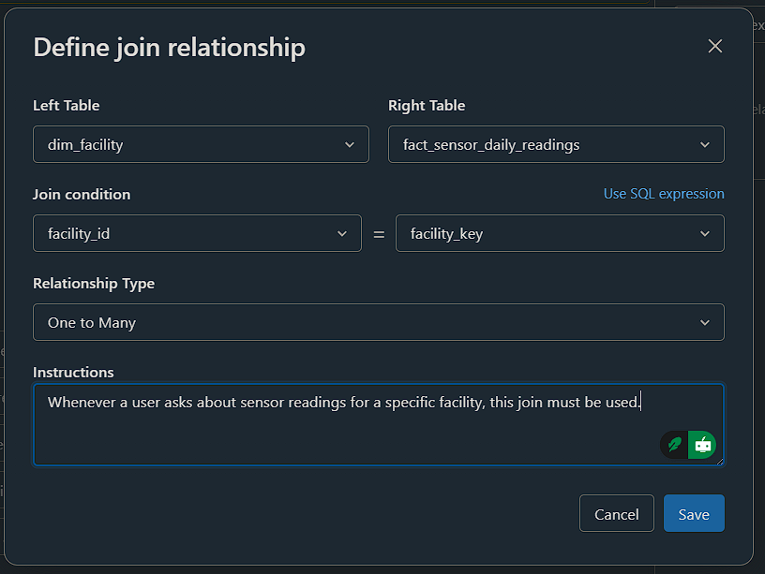
GenAI-Powered Data Assistant
Relationship & Schema Setup:
Defined joins.
Configured tables with instructions for semantic understanding.
Audience-Specific Customization:
Tailored prompts for roles: Plant Managers (KPIs/downtime trends), HSE Engineers (safety incidents/compliance), Climate Scientists (emissions/carbon metrics), Maintenance Technician and Engineers.
Ensures responses are role-relevant, precise, and actionable.

Slide 28
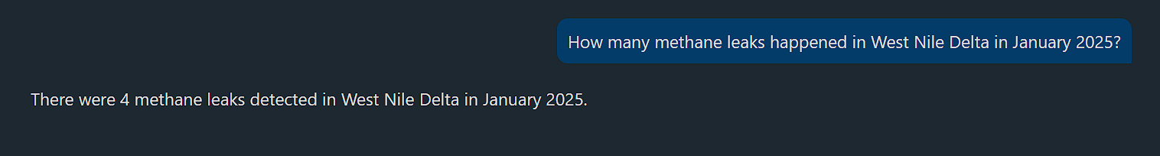
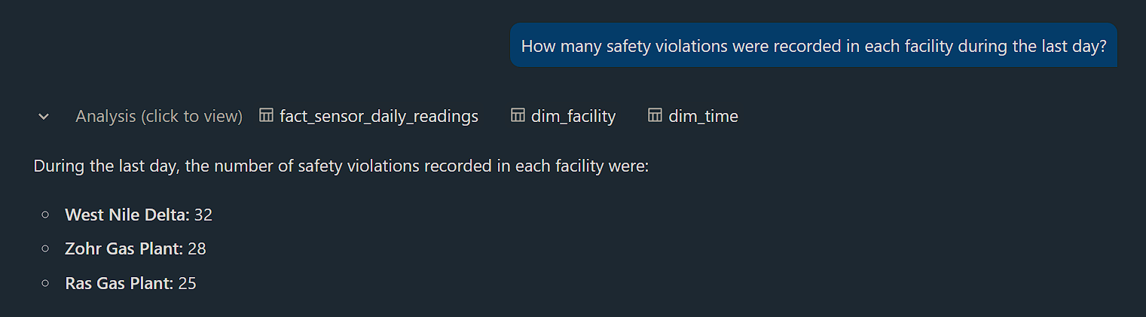
GenAI-Powered Data Assistant

Slide 29
Results and Insights

Slide 30
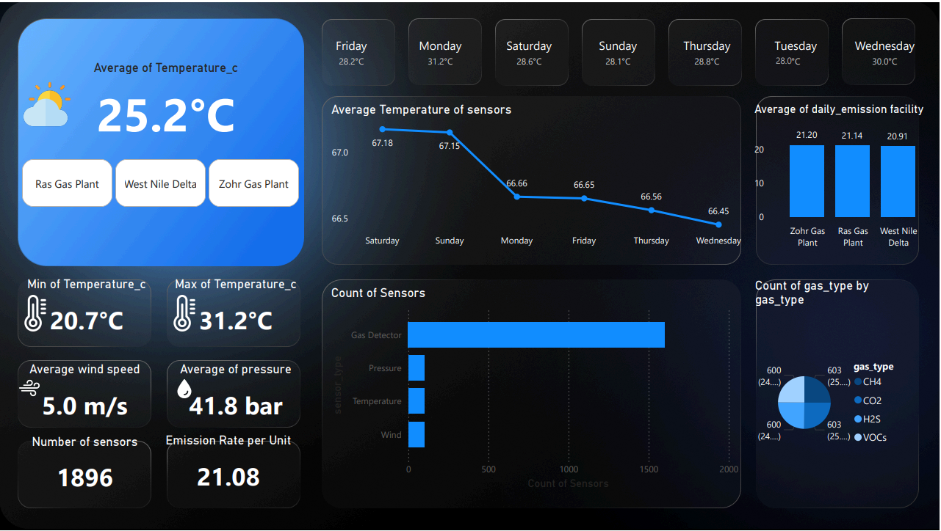

Slide 31
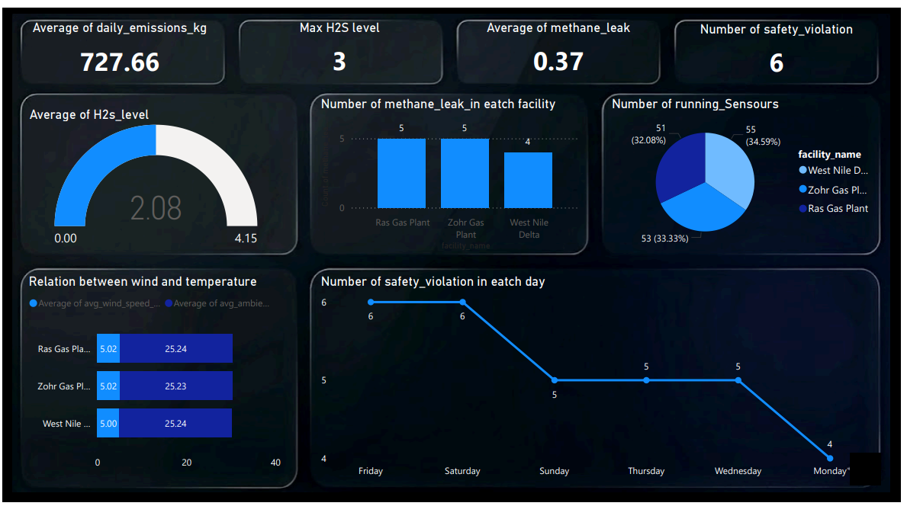

Slide 32
Why This Solution Stand Out?
Hybrid Lambda Architecture: Combines critical real-time safety monitoring with deep historical analytics.
Modern Open Table Format: Leverages Delta Lake to ensure data reliability and ACID transactions
Enterprise Data Governance: Full control and lineage visibility using Unity Catalog.
End-to-End Automation: Fully automated pipelines with zero-touch operations.
CONTEXT-AWARE AI: GENAI AGENT DEPLOYED ON THE GOLD LAYER FOR TRUSTED, BUSINESS-READY INSIGHTS.

Slide 33
Recommendations & Best Practices
Architecture & Pipeline Recommendations
Make Delta Lake the core of the data latform
ACID, Time Travel, Schema Evolution, Z-ordering for blazing-fast queries
Use Delta Live Tables (DLT) as unified processing engine → Same SQL runs on streaming + batch, no code duplication
Add Predictive AI Layer on Gold tables → Forecast leaks, high temperature, or equipment failure before they happen (LSTM, Prophet, AutoML)

Slide 34
Recommendations & Best Practices
Recommendations for Oil & Gas / Energy Companies
Real-time safety monitoring is non-negotiable every second of delay can cost lives, environment, and millions
Deploy AI Assistant / Genie on the Gold layer → Any engineer or manager asks in natural language (English or Arabic) and gets instant answers.
Automated multi-channel alerts (Email + SMS + Teams) for severity ≥3 Immediate notification to HSE, Control Room, and Plant Manager
Keep historical data for ≥7 years in Delta Lake + cold Blob storage Compliance (Egyptian Environmental Law, OSHA, ISO), root-cause analysis, long-term trending

Slide 35
Conclusion
Through the Factory 360 project, we built a strong system to continuously monitor the environment. With the data engineering we implemented, we were able to protect people’s lives and preserve the environment from pollution. The system also helps us make better decisions and improves operational efficiency and safety management in the facilities.
Samsung Innovation Campus

Slide 36
Q&A
ⓒ2020 SAMSUNG. All rights reserved.
Samsung Electronics Corporate Citizenship Office holds the copyright of book.
This book is a literary property protected by copyright law so reprint and reproduction without permission are prohibited.
To use this book other than the curriculum of Samsung innovation Campus or to use the entire or part of this book, you must receive written consent from copyright holder.

